Slide 1
Cardiovascular (Heart) Disease Analysis
Analysis of Various Factors Contributing to Heart Diseases
Using Logistic Regression
- Team 5

Slide 2





OUR TEAM
Amaan Ansari Yuxuan Li Manideep Sharma Nalin Singh Prabhuram Popuri

Slide 3
Table of contents
01
04
02
05
03
06
Overview of The Case
Business Beneficiaries
Data Pre-processing
Conclusions & Improvements
Business Problems & Insights
Q&A

Slide 4

Overview of the Case

Slide 5
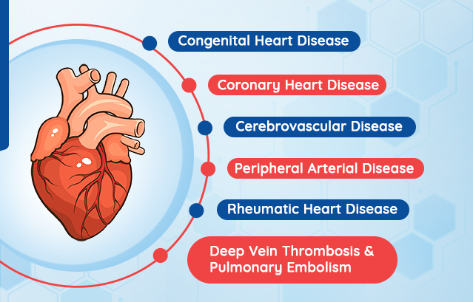
Types of CVDs & Key Numbers
868,000
1m 36s
$352 Billion
Health care system Costs + lost productivity on jobs
Deaths every year due to Heart Diseases in the U.S.
One person dies from heart diseases every 1 min 36 seconds in the U.S.
Notes:
--Cardiovascular diseases (CVDs) are one of the leading causes of death globally.
--Nothing kills more Americans than heart disease and stroke. More than 868,000 Americans die of heart disease or stroke every year—that’s one-third of all deaths. These diseases take an economic toll, as well, costing our health care system $214 billion per year and causing $138 billion in lost productivity on the job.
--Most cardiovascular diseases can be prevented by addressing behavioural risk factors such as tobacco use, unhealthy diet and obesity, physical inactivity, and harmful use of alcohol
--It is important to detect cardiovascular disease as early as possible so that management with counselling and medicines can begin.

Slide 6
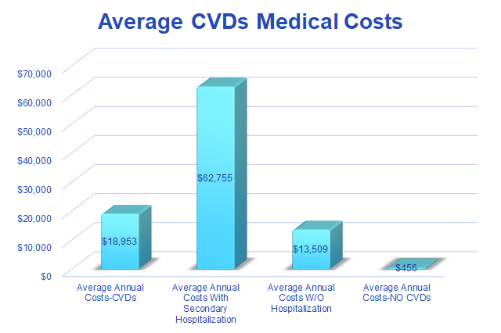
CVDs Medical Costs
"Financial Toxicity" - Almost half of U.S. heart disease patients struggle with medical bills
Not surprisingly, CVDs are the costliest of all diseases, the total mean direct medical care costs for patients with established cardiovascular disease (CVD) were $18,953 per patient per year.
Notes:
1. "The costs of surviving cardiovascular disease: It’s enough to give you a heart attack!"
2. “financial toxicity,” refers to patients who have chronic diseases such as heart-related diseases stressed form their medical bills. The stress causes side effects on par with complications from drugs or surgery that can have lasting effects on patients’ physical and mental health.
Source:"https://www.reuters.com/article/us-health-heart-finances/almost-half-of-u-s-heart-disease-patients-struggle-with-medical-bills-idUSKCN1Q02HF"
3. Costs for persons who were not hospitalized for CVD during follow-up were about 30% lower than the mean, suggesting that successful prevention efforts could substantially reduce the economic burden of CVD.

Slide 7
Aim and Objectives
Our Case
To identify the most significant predictors of heart disease and predicting the overall risks by using Classification model (Logistic Regression).

Slide 8
Data Pre-Processing

Slide 9
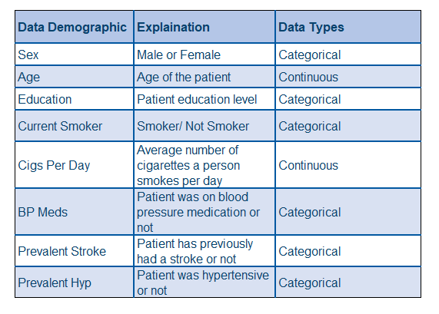
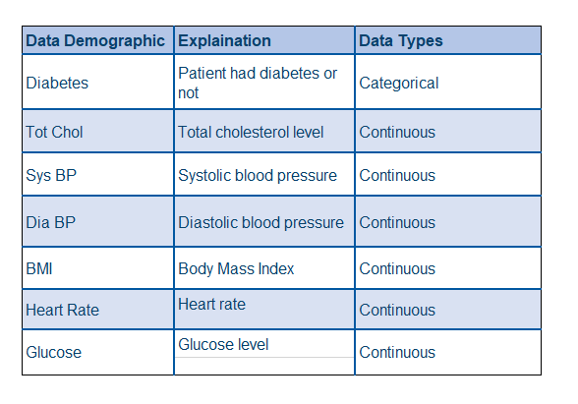
Dataset Introduction
Type and Classification of Data Acquired
Data acquired from: https://www.kaggle.com/dileep070/heart-disease-prediction-using-logistic-regression

Slide 10
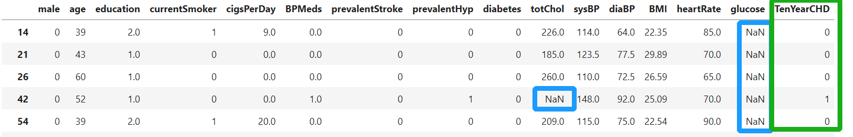
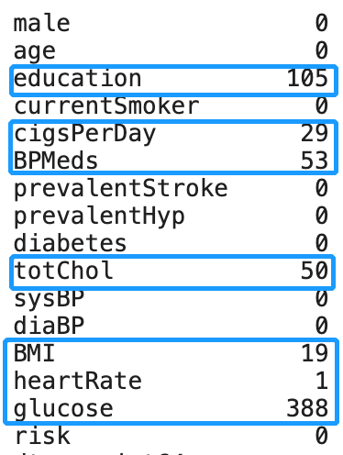
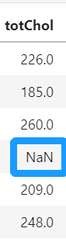
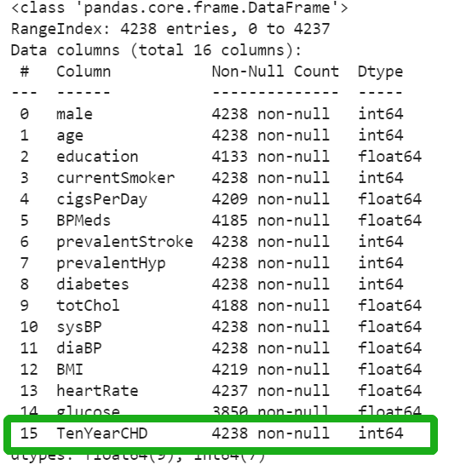
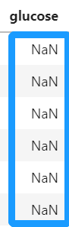
Issues with Data
2
1
1
Missing Values
Column Re-Name
2
1
The name of the target variable is not straightforward and may cause confusion.
There are some fields which have missing data.

Slide 11
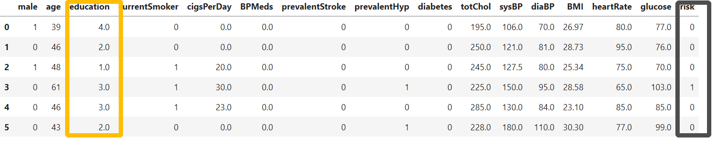
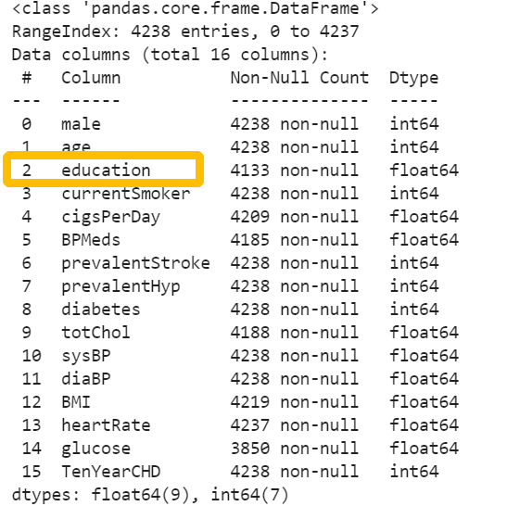
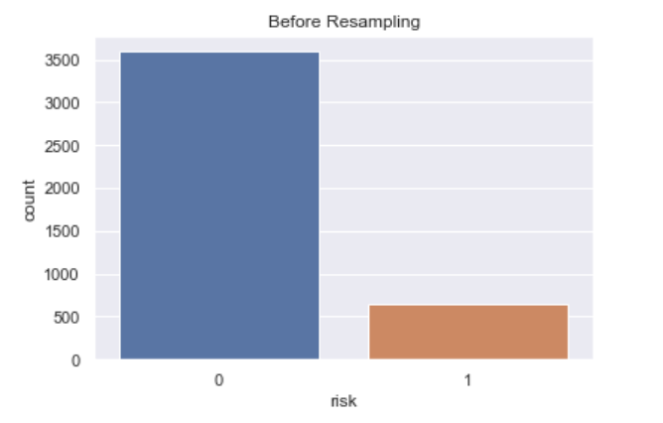
Issues with Data
3
4
Imbalanced Data
Unrelated Column
4
3
“Education“ column is an unrelated column and might not give significant information
Imbalanced classes(0,1) in the dataset leads to skewed model accuracy.

Slide 12

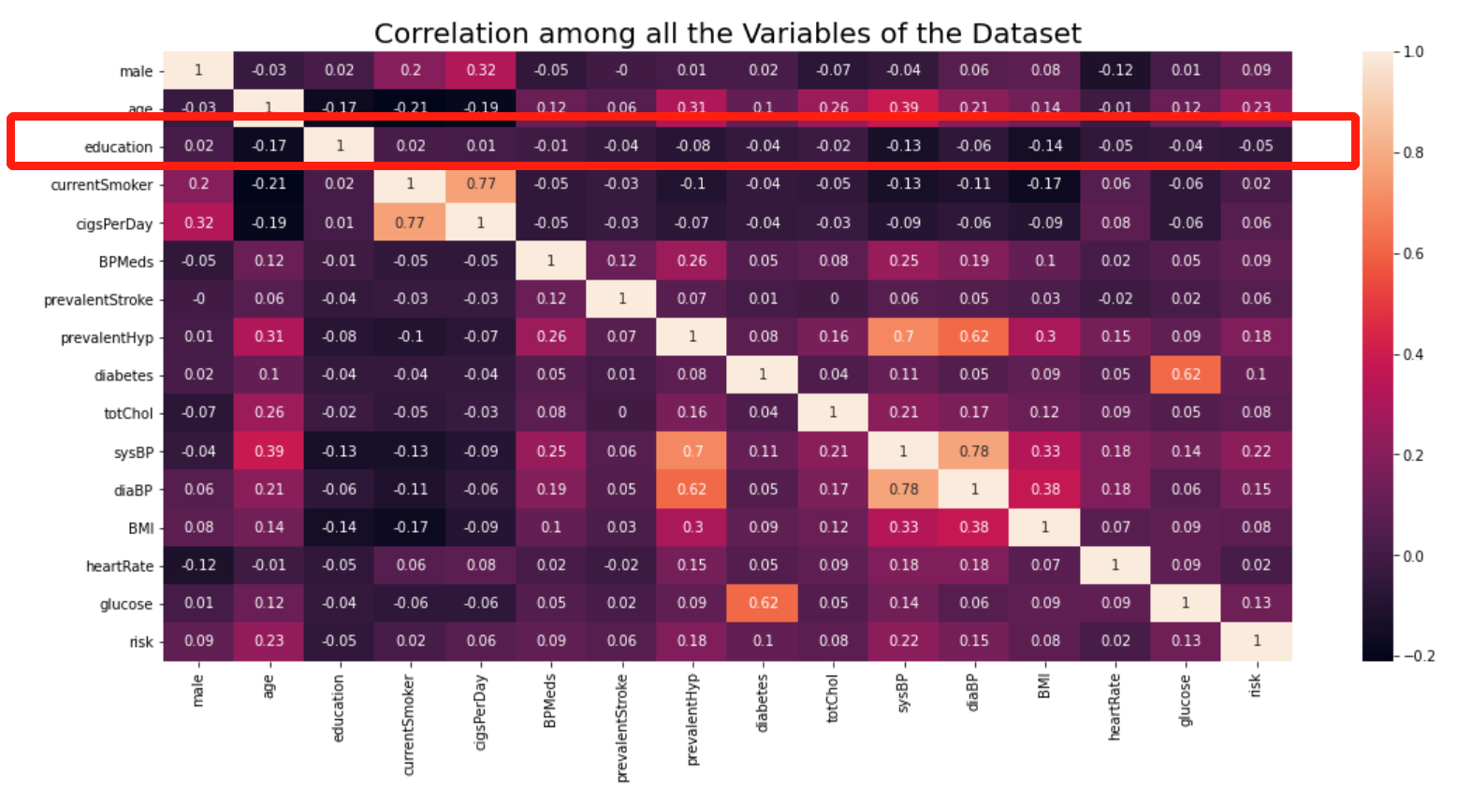
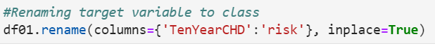
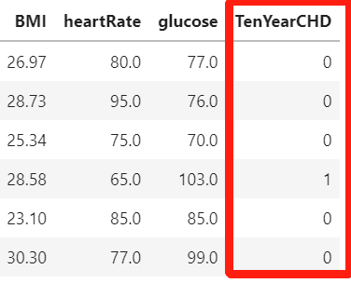
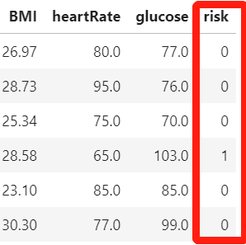
Data Cleaning
Drop Unrelated Column
Changing Column Names
Dropping 'education' column as it is uncorrelated from other feature and does not provide any business context to the problem

Slide 13
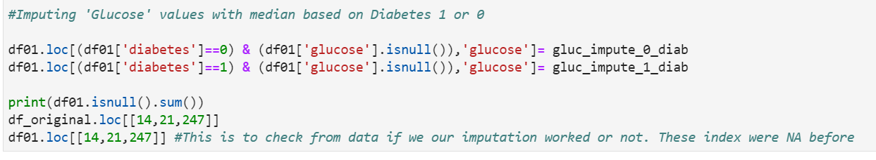
Data Imputation
We use different imputation methods for different variables with missing values
01
02
03
04
Grouping
Computation
Imputation
Checking
Group "glucose" with Yes/No "diabetes"

Slide 14
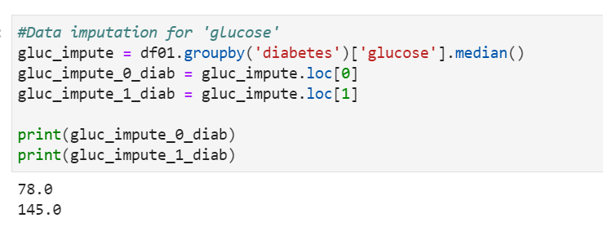
Data Imputation - "glucose"
01
02
03
04
Grouping
Computation
Imputation
Checking
Compute the median of "glucose" in different groups

Slide 15
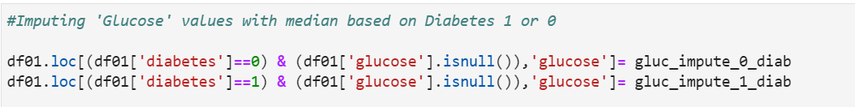
Data Imputation - "glucose"
01
02
03
04
Grouping
Computation
Imputation
Checking
Substitute the median with NaN in "glucose"

Slide 16
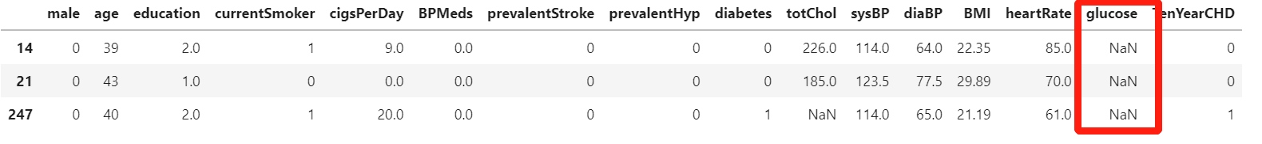
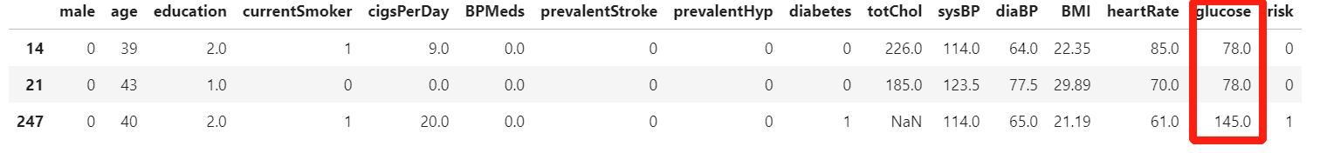
Data Imputation - "glucose"
01
02
03
04
Grouping
Computation
Imputation
Checking
Checking the current values of "glucose"

Slide 17
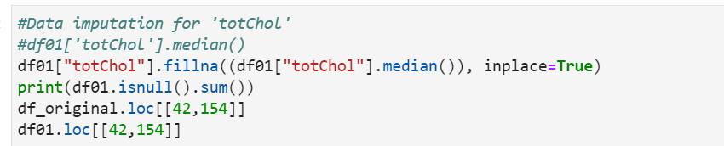
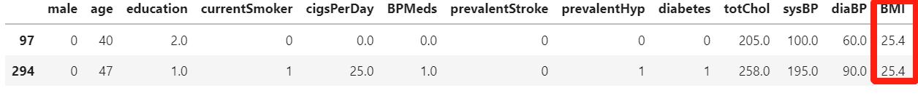
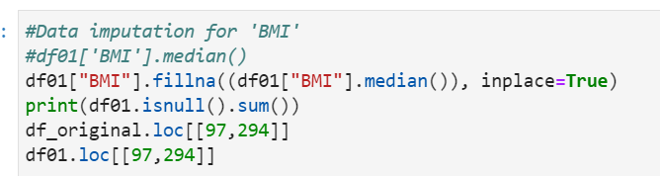
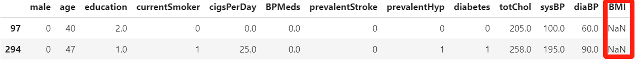
Data Imputation - "totChol”, "BMI"
"totChol"
“totChol” Imputation – Imputing missing values with median of cholesterol of the dataset
"BMI"​
“BMI” Imputation – Imputing missing values with median of BMI of the dataset

Slide 18
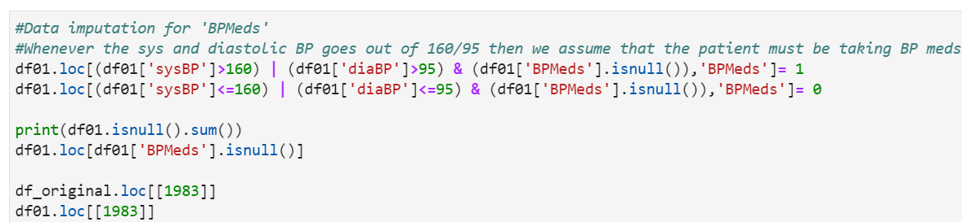
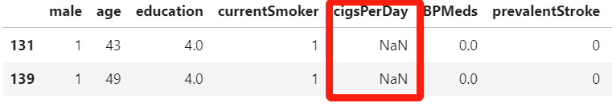
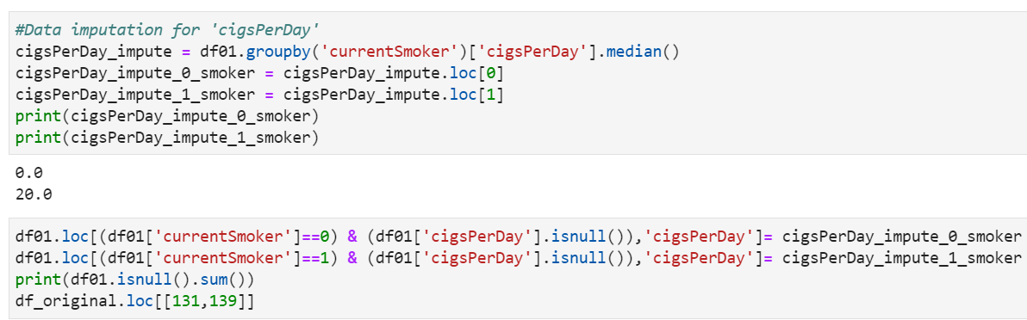
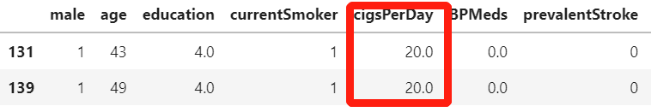
Data Imputation - "BPMeds", "cigsPerDay"
"BPMeds"
“BMMeds” Imputation – Imputing missing values with the condition if systolic bp >=160 and diastolic bp >=95
"cigsPerDay”
​
“cigsPerDay” Imputation – Imputing missing values with the condition that if patient is current smoker, then median of cigs per day for those patients, else 0

Slide 19
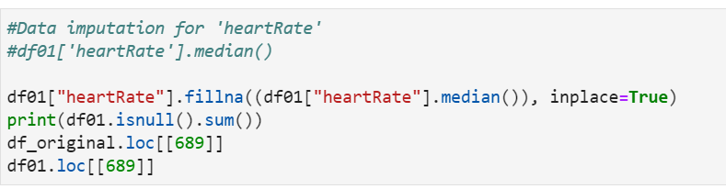
Data Imputation - "heartRate"
"heartRate"
“heartRate” Imputation – Imputing missing values with the median of the data set.

Slide 20
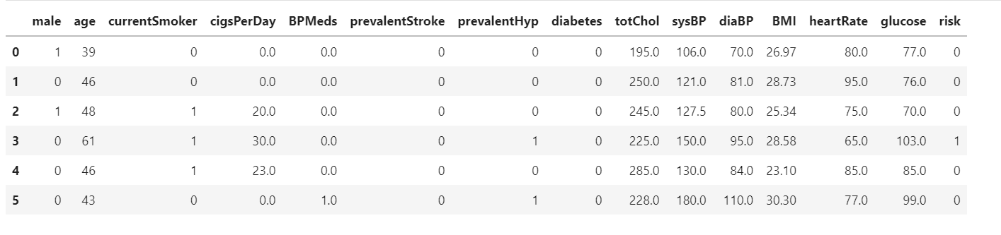
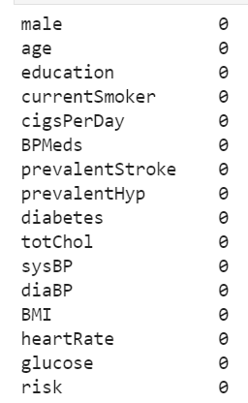
Data After Cleaning
Before Imputing The Missing Data
After Imputing The Missing Data

Slide 21
Exploratory Data Analysis (EDA)
We employed various EDA methods to help us determine–
Classification of categorical variables
Variable Variation
Correlation between variables
Relevance Factor of different variables on the output variable (risk)

Slide 22
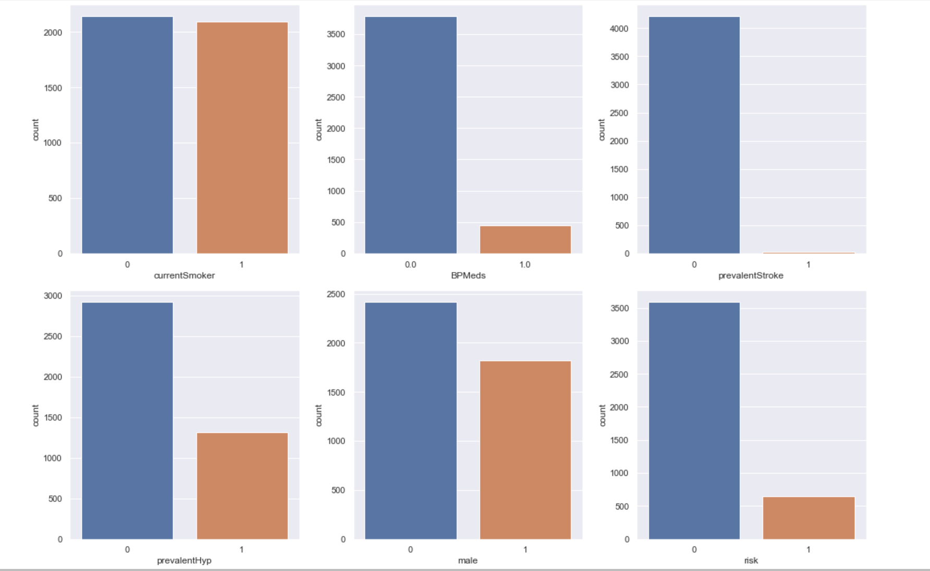
Classification of Categorical Variables

Slide 23
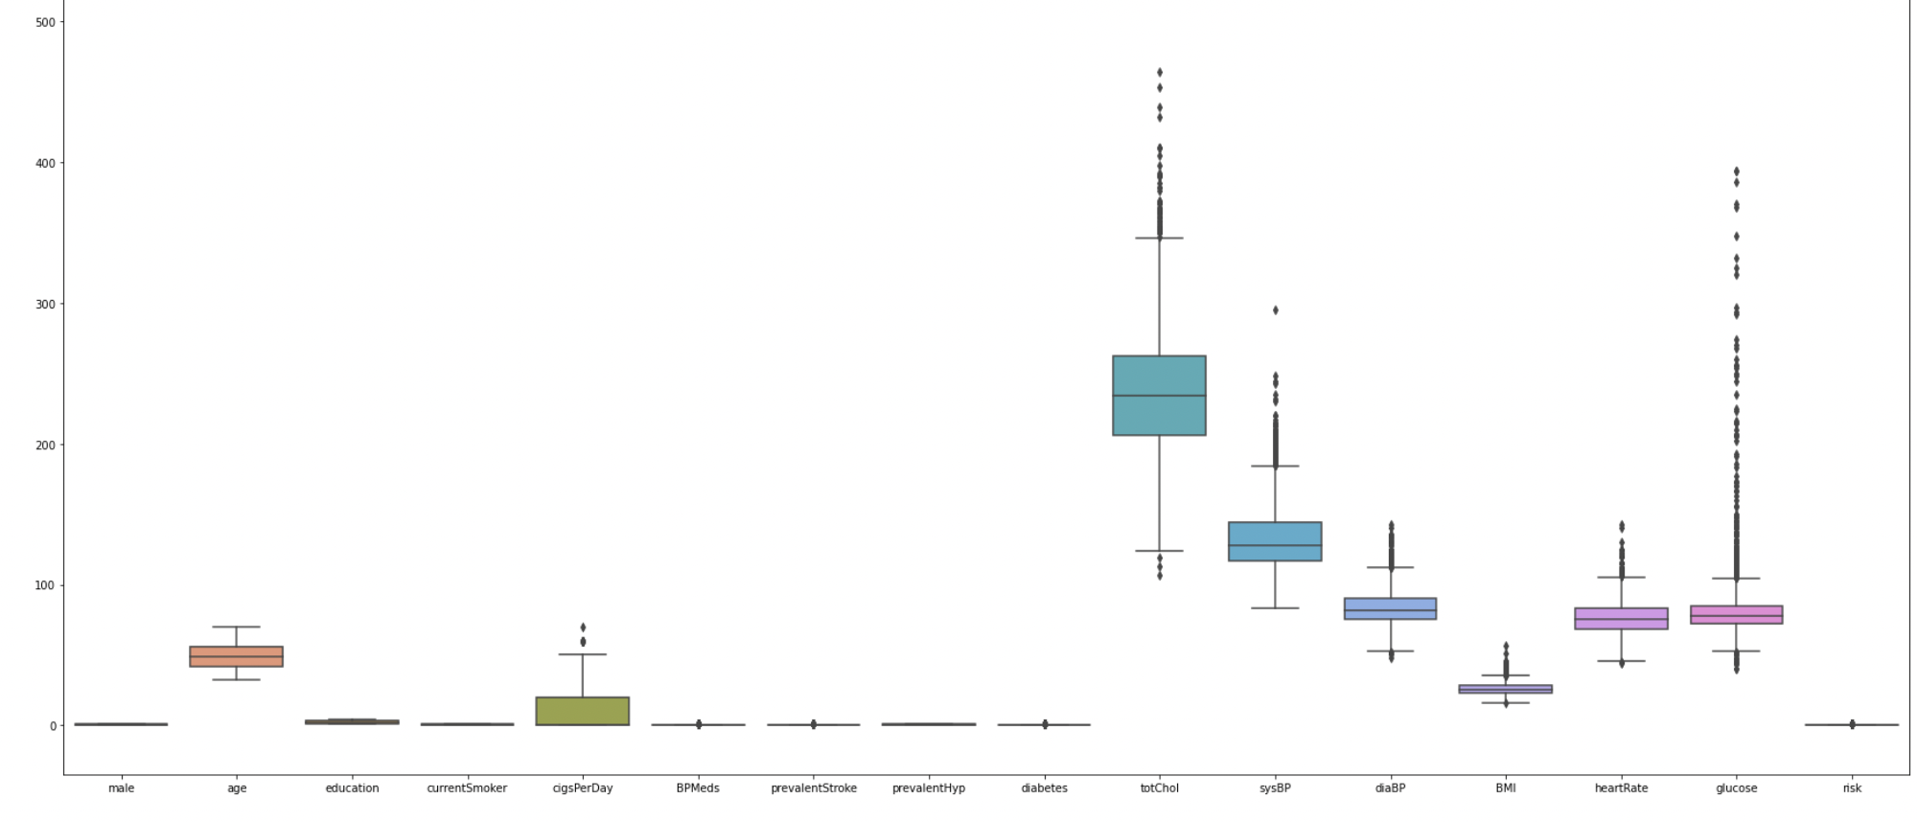
Variation of Variables in Box-Plot Diagram
Variation
Variables

Slide 24
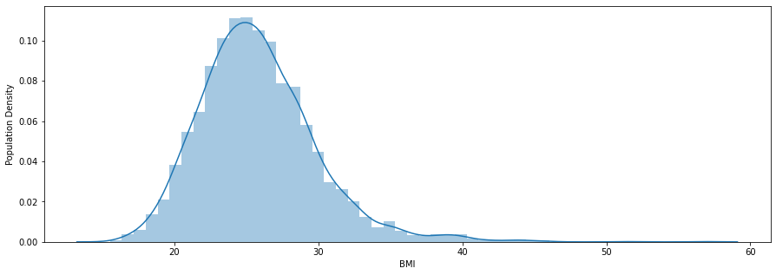
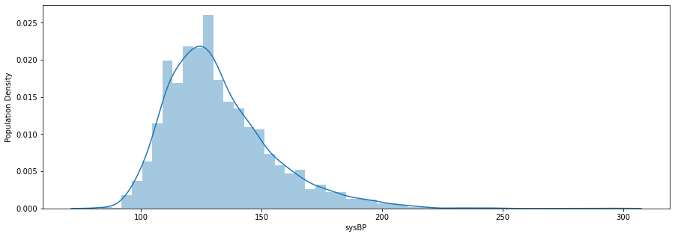
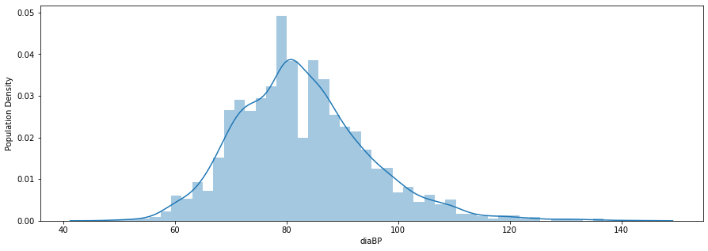
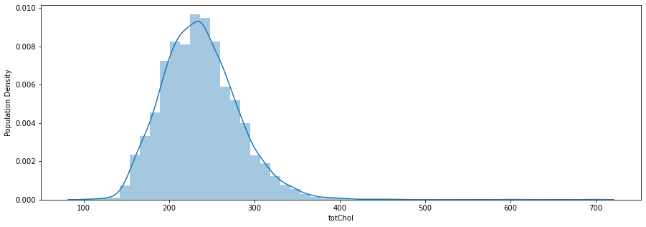
Population Density of Continuous Variables

Slide 25
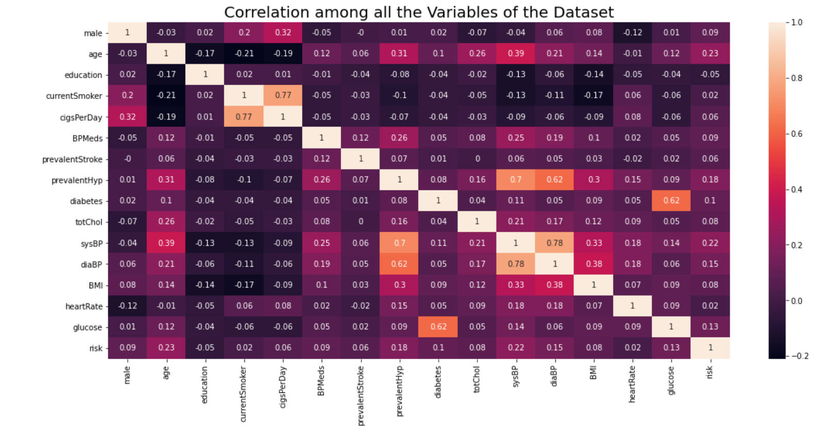
Correlation Matrix Between Variables
Variables
Decreasing Correlation Factor Between Variables
Variables

Slide 26
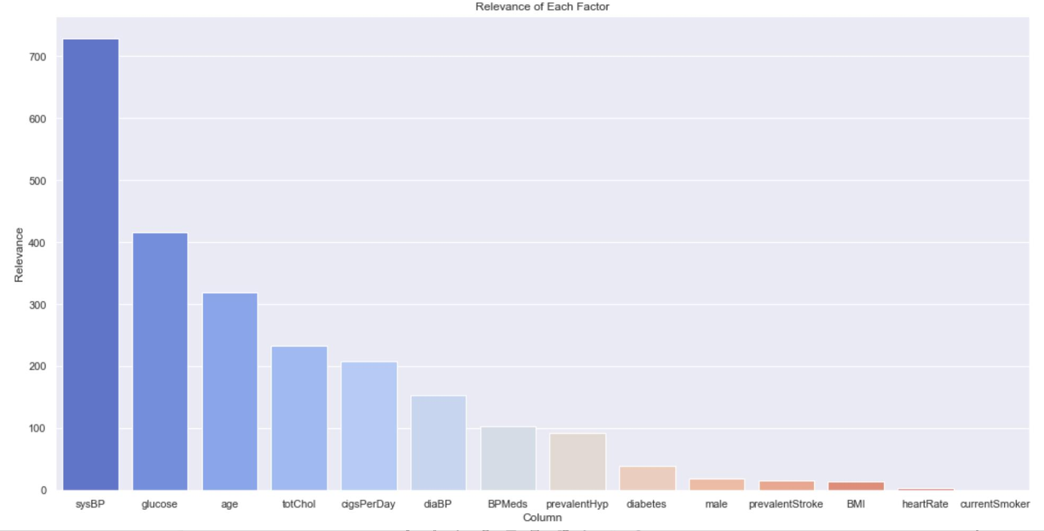
Relevance of Each Variable w.r.t. the Risk
Relevance
Increasing Relevance of Variables
Variables

Slide 27
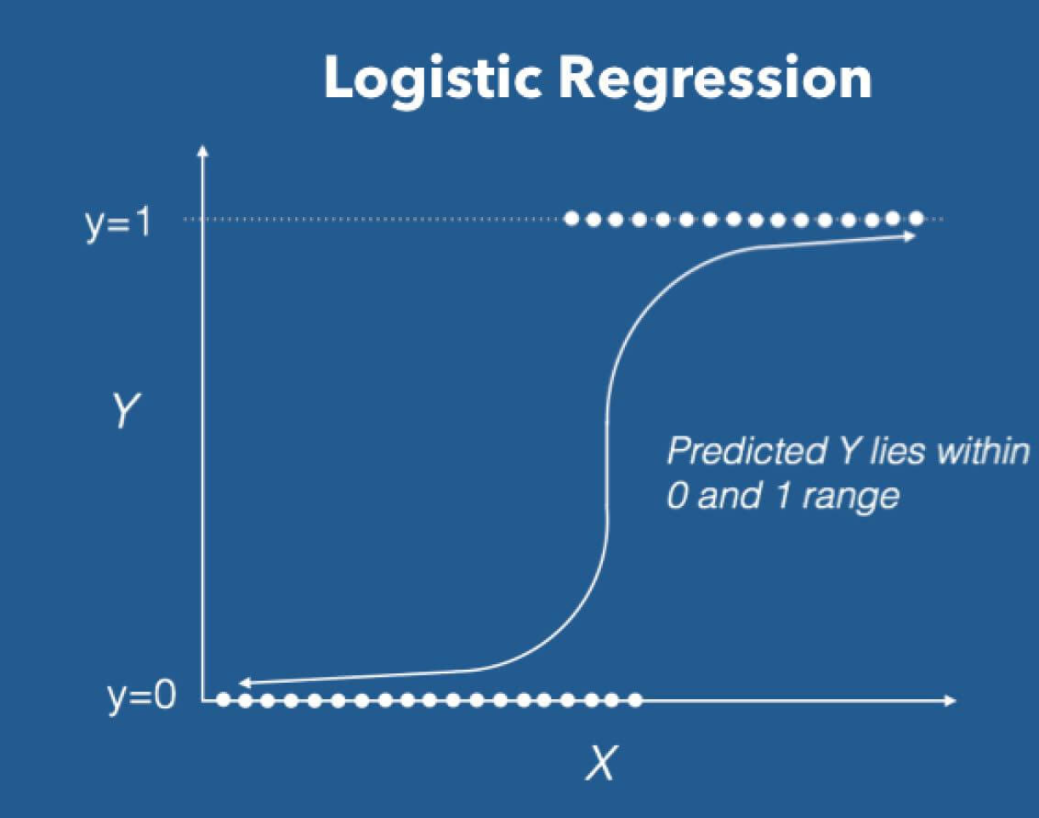
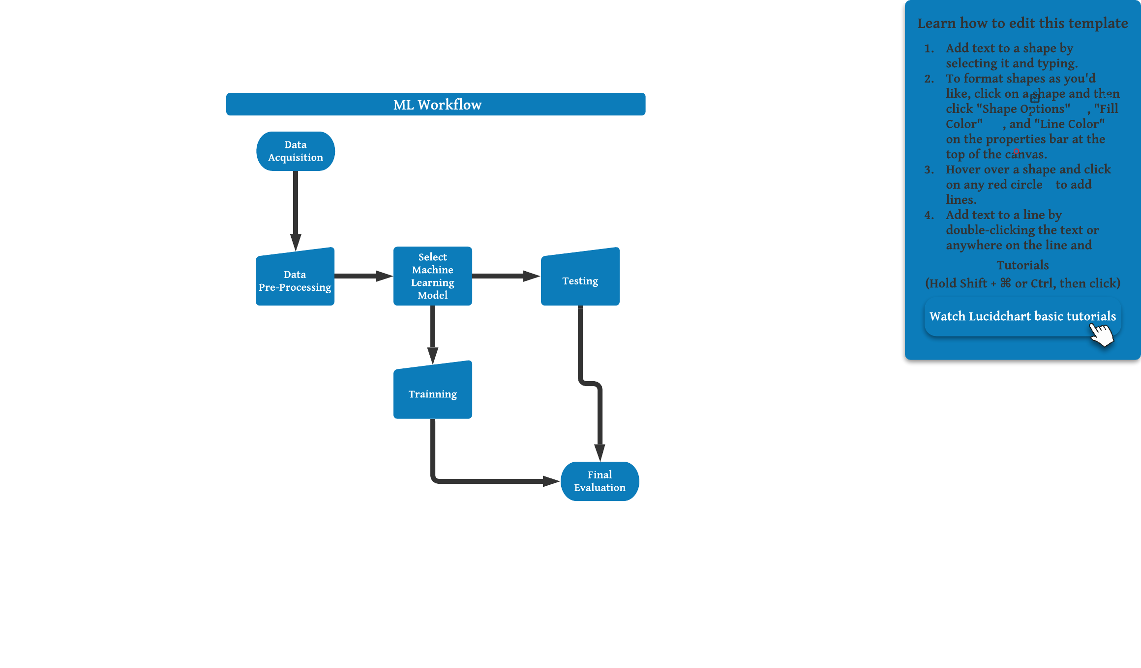
Methodologies Employed
Machine Learning (ML):
ML is a method of analyzing data, learning from it, and then predicting the desired outcome. In our case we use supervised learning classification algorithm.
Logistic Regression:
One of the ML classification algorithms for analyzing a dataset in which there are one or more independent variables .
Here we are using Binary logistics regression, where a dependent variable will be either 1 or 0.
Notes:
https://www.analyticsvidhya.com/blog/2021/07/perform-logistic-regression-with-pytorch-seamlessly/

Slide 28
Business Problems and Insights

Slide 29
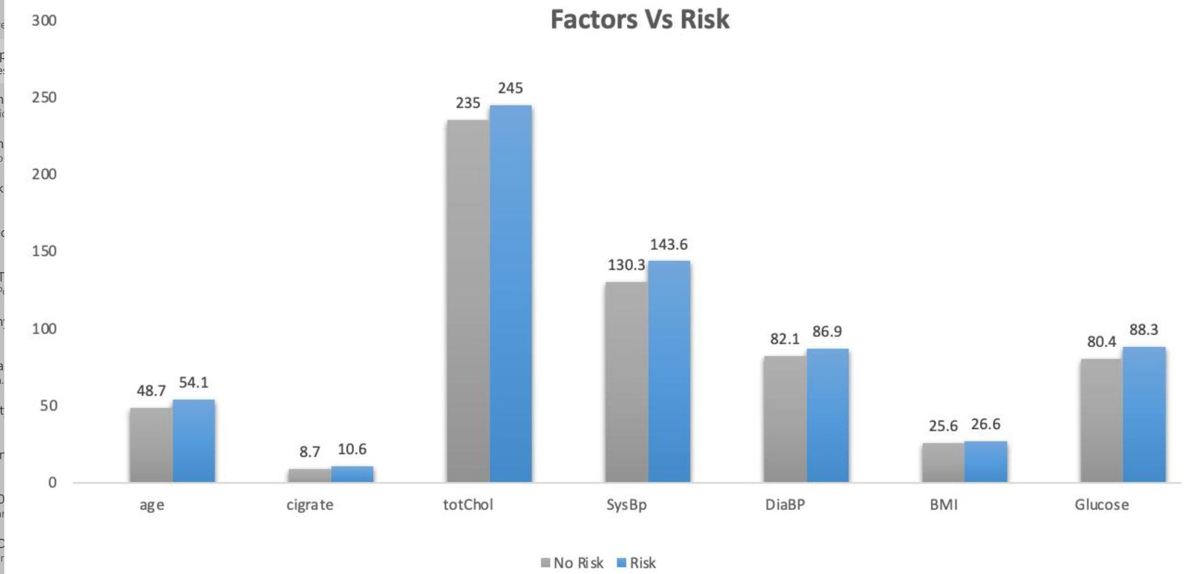
General Insights

Slide 30
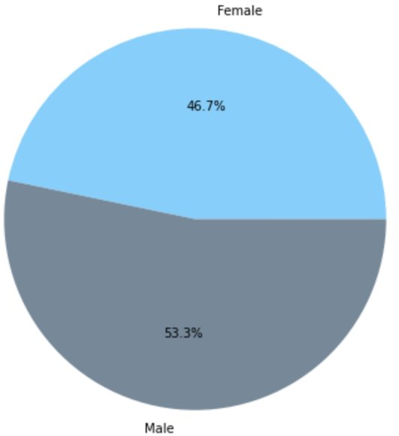
Question 1: Are women at a higher risk for heart disease than men? No!
Heart Disease Risk per Gender
Female
46.7%
Male
53.3%

Slide 31


Inference
Based on the result, men are more likely to suffer from CVDs than women.
Business Implication
Insurance Companies can leverage such findings by keeping a premium of men higher than that for women in CVD coverage.
FMCG/ Retail / Pharmaceutical Companies can come up with male gender specific dietary products/ supplements that help and enable men in reduced risk of CVDs.

Slide 32
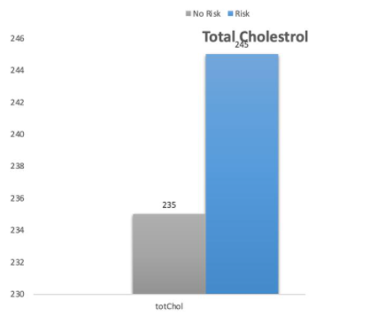
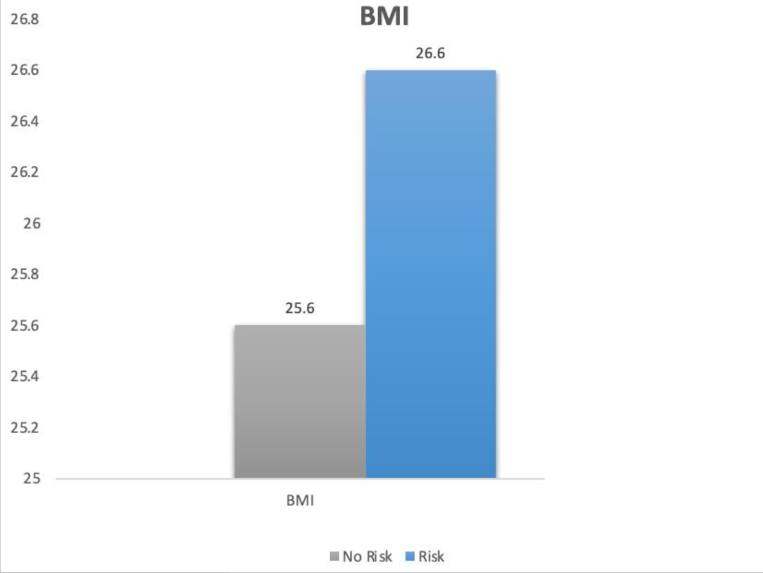
Question 2: How do BMI and total cholesterol level relate to the risk of CVDs?
Risk
No Risk

Slide 33
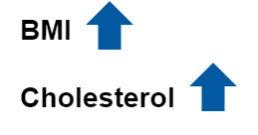
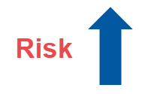


Business Implication
Fitness and Health Industry – Such industries can leverage the findings and data to target people who are overweight/ have a higher BMI and higher cholesterol level by targeting them as a separate customer segment.
Food Industry/ Dieticians – Such industry can leverage this data by custom tailoring meals for people who have a higher BMI and cholesterol by adding more fiber, protein, good fats, etc., in meal plans that would supplement their weight and cholesterol reduction regime.

Slide 34
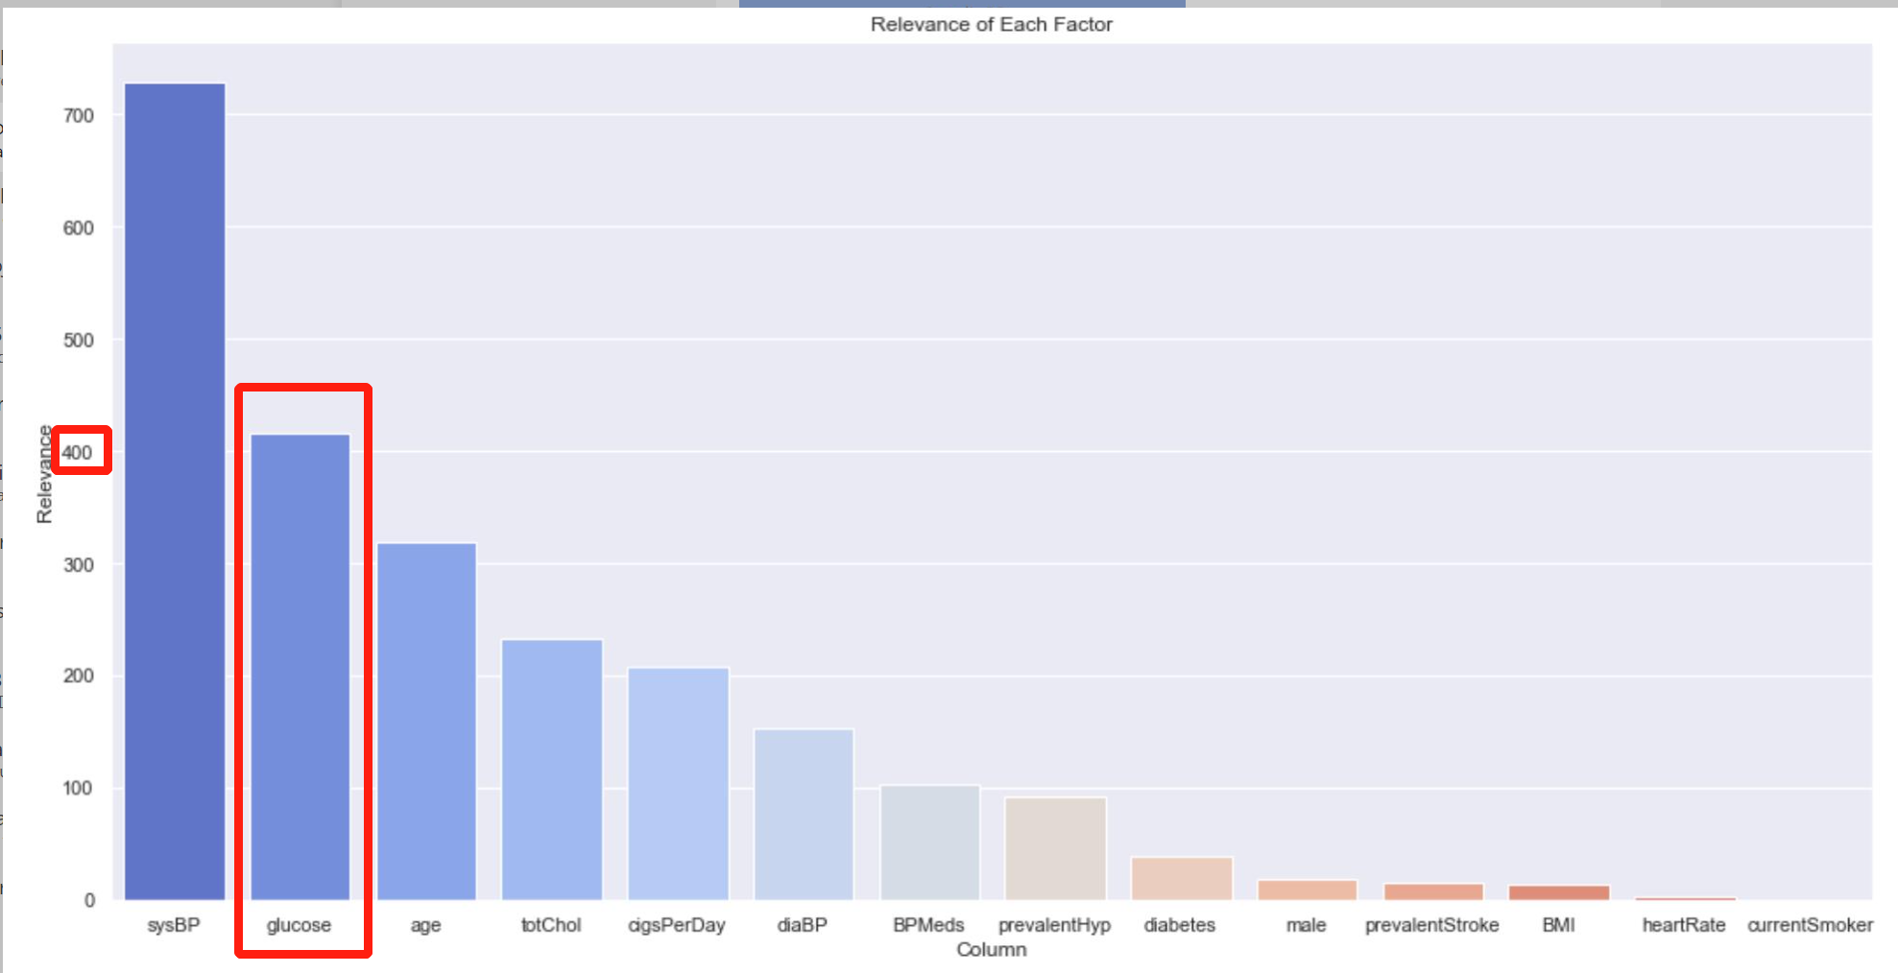
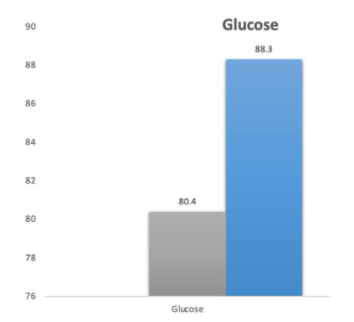
Question 3: Do people with higher glucose values are also more likely to have a heart failure? Yes!
Risk
No Risk

Slide 35

Inference
Glucose was the second most relevant factor when it was observed in the Relevance Factor Graph. Post-Regression Analysis shows us that people who have a higher glucose value than normal.
Business Implication
Healthcare and Pharmaceutical industry – Healthcare industry can leverage the most out of such analysis. They can create regimes to treat and hep people keep a lower glucose level which in turn can also help them reduce their risk of CVDs and Diabetics.
Health and Fitness Industry – Health and fitness industry can target people who have a higher glucose level by informing and helping them reduce their glucose levels.

Slide 36



Question 4 : Are older people more likely to have a heart failure? Yes!
High risk
Low risk
No Risk
Risk

Slide 37

Inference
It is observed that people who are older have a higher chance of suffering from CVD diseases where the average of people at risk is 54.1.
Business Implication
Insurance Industry – Insurance industries can use this finding to implement a higher premium on their packages for adults.
Healthcare Industry - Healthcare industries can leverage this analysis by providing special care packages and health improvement regime packages for elderlies who have a high risk of CVDs.

Slide 38


Recommendation / Conclusion:
Highest Contributing Factors
Patient profile 1:
Male patients at age of 55 who has high Systolic Blood Pressure and, high Glucose level, high Cholesterol level, and smoke on an average 11 cigarettes every day has a high risk of suffering from heart failure.
Age
Sex
Cigarets/day
Glucose
BMI
Total Cholesterol
Systolic Blood Pressure
Patient profile 2:
Female patients at age of 24 who have high BMI and previously had a stroke have a low risk of suffering from heart failure.
Notes:
Sex, age, cigarettes per day, diastolic blood pressure, BMI, heart rate, hypertension, diabetes, and blood pressure medication are useful in predicting the overall risks of ten-year CVDs
Male are more likely to suffer from CVDs than Female.
High Systolic Blood Pressure, one of the leading contributors to CVDs, is a direct contributor but may have several causes which makes it difficult to decipher the actual cause and industry

Slide 39
Conclusions and Improvements

Slide 40
Scope of Improvement
There are some data points, qualitative and quantitative, that can help us understand and get a better prediction model.
Some of them are :
More balanced data
Descriptive data on hypertension causes
More data features
Information on Hereditary diseases
Causes of high Systolic Blood Pressure

Slide 41
Q & A

Slide 42
Thanks!

Slide 43
Appendix

Slide 44



Model implementation: Logistic regression
Confusion Matrix
Model Fitting & Creating Confusion Matrix

Slide 45


Handling Imbalanced response Class :

Slide 46


Model Performance:
Accuracy = 60%
AUC score = 66%

